Slide 1


Network protocols & security
24EC2210
Topic:
Email, SMTP
Session - 32

Slide 2
AIM OF THE SESSION
To familiarize students with the basic concept of Application Layer Protocols
INSTRUCTIONAL OBJECTIVES
LEARNING OUTCOMES
This Session is designed to:
Introduction to Application Layer.
Basic components of E-mail-SMTP,POP3.
At the end of this session, you should be able to:
1. Write a short note on E-Mail and SMTP.
Describe POP3.
List out various protocols in application layer

Slide 3
Application Layer Protocols
The application layer is present at the top of the OSI model. It is the layer through which users interact. It provides services to the user.
E-mail
SMTP
POP3
IMAP
HTTP

Slide 4
Email Architecture and Services
Typically, e-mail systems support five basic functions.
1. Composition refers to the process of creating messages and answers.
2. Transfer refers to moving messages from the originator to the recipient.
3. Reporting has to do with telling the originator what happened to the message. Was it delivered? Was it rejected? Was it lost?
4. Displaying incoming messages is needed so people can read their e-mail.
5. Disposition is the final step and concerns what the recipient does with the message after receiving it.

Slide 5

Email Architecture
Three major components:
User Agents (UA)
Mail servers
Simple Mail Transfer Protocol: SMTP
user
agent
mail
server
user
agent
SMTP
User Agent
a.k.a. “mail reader”
composing, editing, reading mail messages
Mail servers:
mailbox contains incoming messages for user
message queue of outgoing (to be sent) mail messages
SMTP protocol:
Used between mail servers to send email messages
client: sending mail server
server: receiving mail server
mail
server
user
agent
SMTP
SMTP
user
agent
mail
server
user
agent
user
agent
outgoing message queue
user mailbox

Slide 6
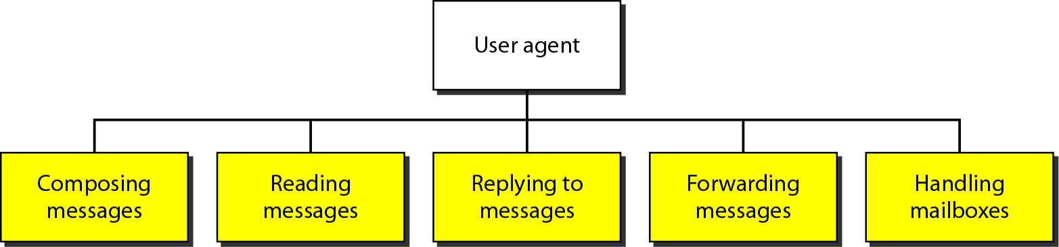
Services of user agent

Slide 7
Electronic Mail: SMTP [RFC 2821]
Uses TCP to reliably transfer email message from client to server, port 25
Direct transfer: sending server to receiving server
Three phases of transfer
Handshaking (greeting)
Transfer of messages
Closure
messages must be in 7-bit ASCI

Slide 8
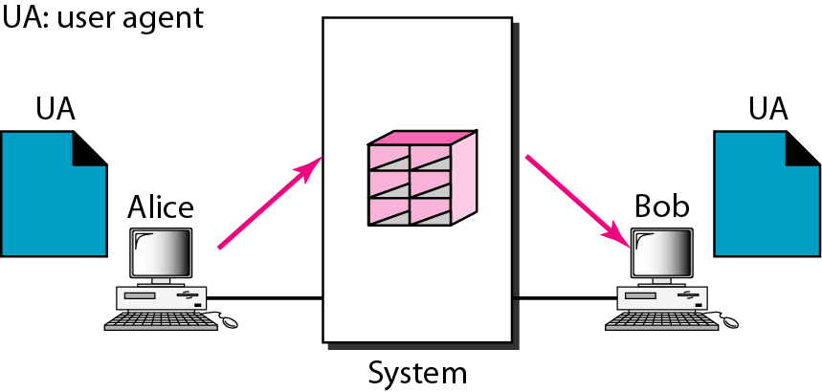
First scenario in electronic mail
When the sender and the receiver of an e-mail are on the same system, we need only two user agents.

Slide 9
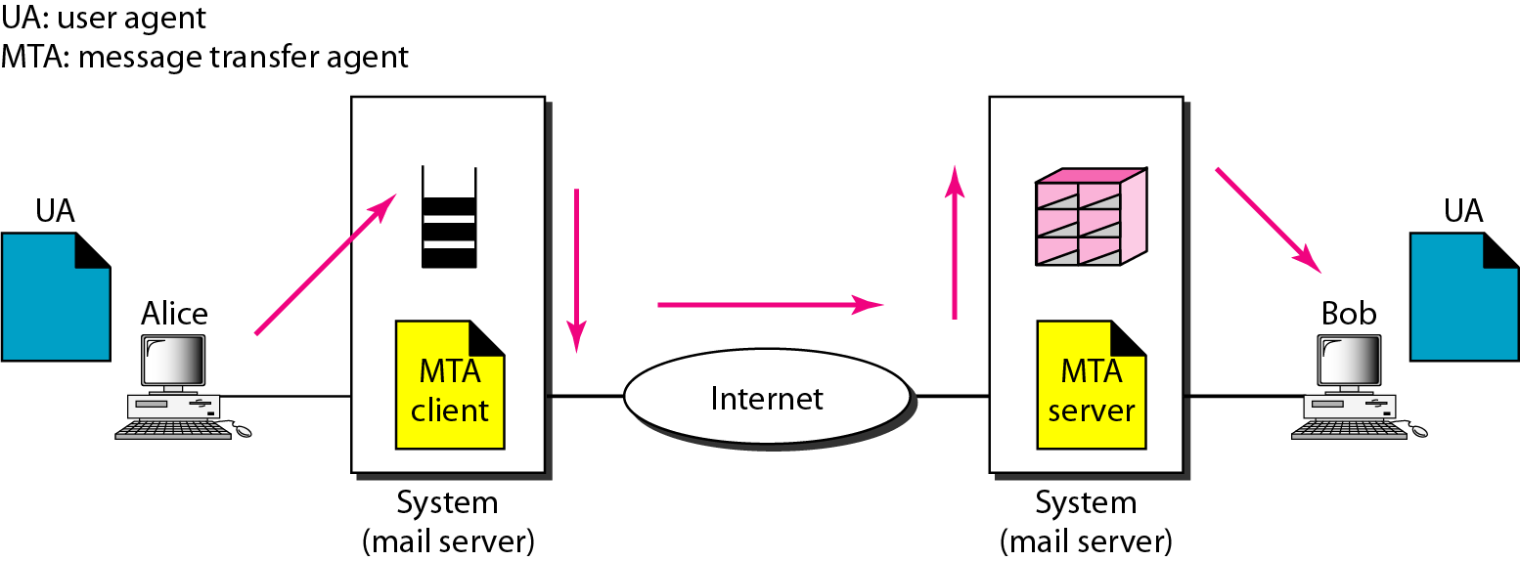
Second scenario in electronic mail
When the sender and the receiver of an e-mail are on different systems, we need two UAs and a pair of MTAs (client and server).

Slide 10
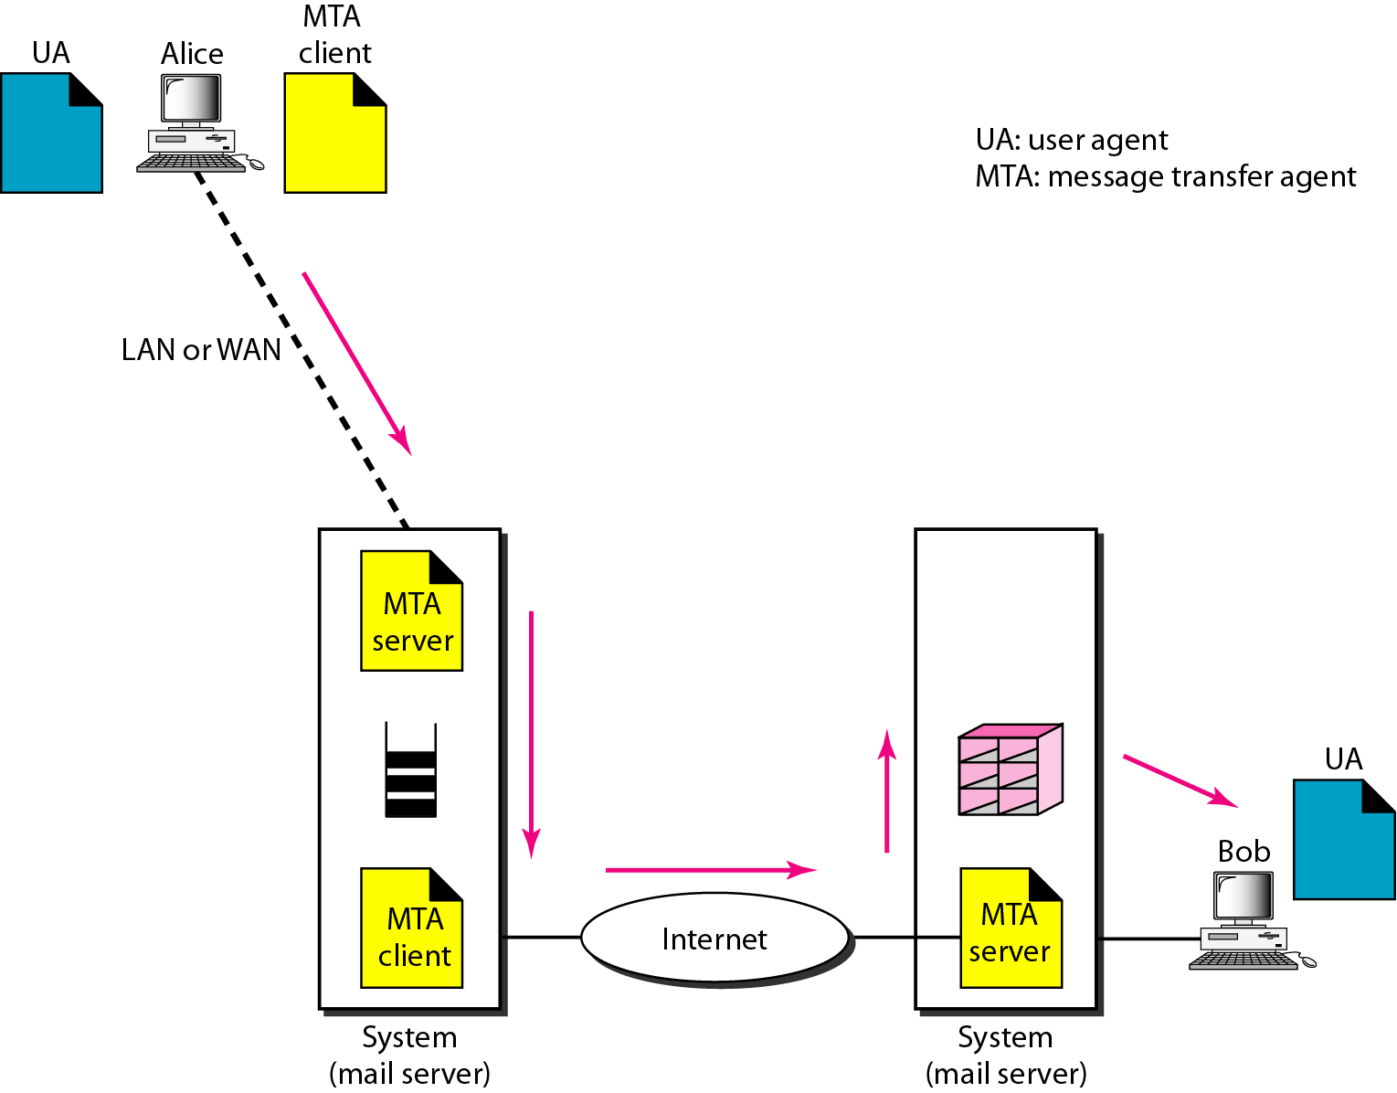
Third scenario in electronic mail
When the sender is connected to the mail server via a LAN or a WAN, we need two UAs and two pairs of MTAs (client and server).

Slide 11
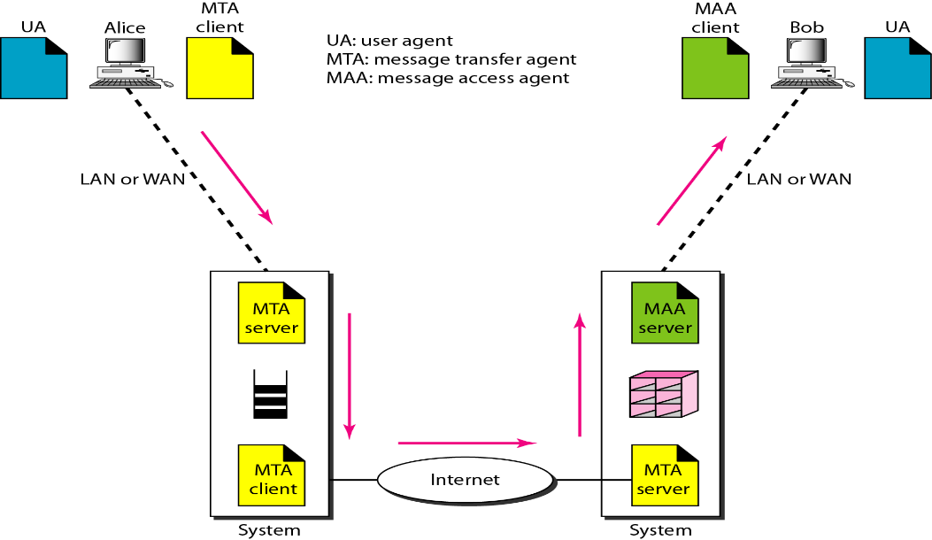
Fourth scenario in electronic mail
When both sender and receiver are connected to the mail server via a LAN or a WAN, we need two UAs, two pairs of MTAs and a pair of MAAs.
This is the most common situation today.

Slide 12
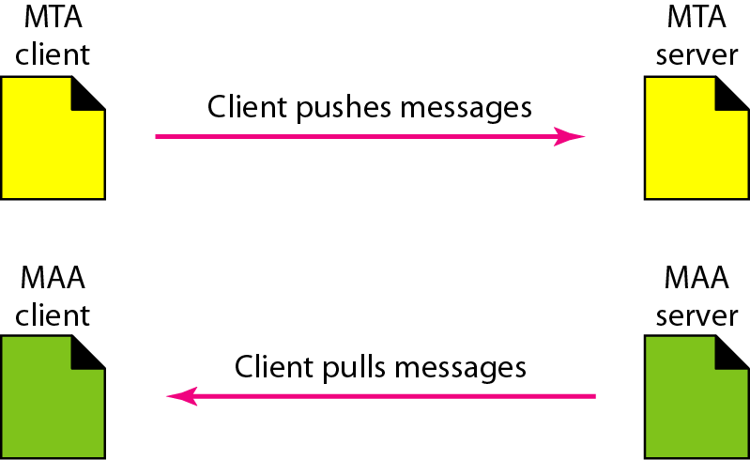
Push versus pull in electronic email

Slide 13
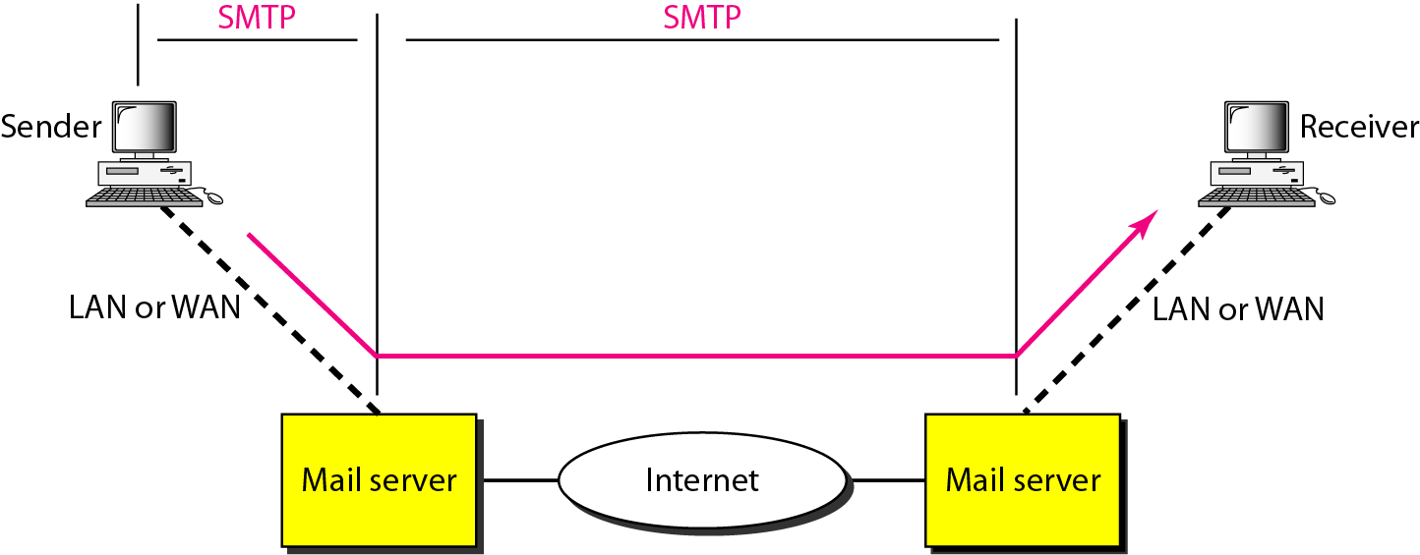
SMTP range

Slide 14


Mail access protocols
user
agent
mail access
protocol
user
agent
SMTP
SMTP
(e.g., POP,
IMAP)
sender’s mail
server
receiver’s mail
server
SMTP: Delivery/Storage to Receiver’s Server.
Mail Access protocol: Retrieval from server
POP (Post Office Protocol): Authorization, download
IMAP (Internet Mail Access Protocol): More features, including manipulation of stored messages on server.

Slide 15
POP3 (Post Office Protocol Version3)
POP stands for Post Office Protocol. It is generally used to support a single client.
There are several versions of POP but the POP 3 is the current standard.
POP is an application layer internet standard protocol.
Since POP supports offline access to the messages, thus requires less internet usage time.
POP does not allow search facility.
In order to access the messages, it is necessary to download them.
It allows only one mailbox to be created on server.
It is not suitable for accessing non mail data.
POP commands are generally abbreviated into codes of three or four letters. Eg. STAT.

Slide 16
IMAP (Internet Message Access Protocol)
IMAP stands for Internet Message Access Protocol. It was first proposed in 1986.
IMAP allows the client program to manipulate the e-mail message on the server without downloading them on the local computer.
The e-mail is hold and maintained by the remote server.
It enables us to take any action such as downloading, delete the mail without reading the mail. It enables us to create, manipulate and delete remote message folders called mail boxes.
IMAP enables the users to search the e-mails.
It allows concurrent access to multiple mailboxes on multiple mail servers.

Slide 17
Comparison between POP and IMAP
S.No | POP | IMAP
1 | Generally used to support single client. | Designed to handle multiple clients.
2 | Messages are accessed offline. | Messages are accessed online although it also supports offline mode.
3 | POP does not allow search facility. | It offers ability to search emails.
4 | All the messages have to be downloaded. | It allows selective transfer of messages to the client.
5 | Only one mailbox can be created on the server. | Multiple mailboxes can be created on the server.
6 | Not suitable for accessing non-mail data. | Suitable for accessing non-mail data i.e. attachment.
7 | POP commands are generally abbreviated into codes of three or four letters. Eg. STAT. | IMAP commands are not abbreviated, they are full. Eg. STATUS.
8 | It requires minimum use of server resources. | Clients are totally dependent on server.
9 | Mails once downloaded cannot be accessed from some other location. | Allows mails to be accessed from multiple locations.
10 | The e-mails are not downloaded automatically. | Users can view the headings and sender of e-mails and then decide to download.
11 | POP requires less internet usage time. | IMAP requires more internet usage time.

Slide 18
SUMMARY
This unit provides a complete overview of application layer of TCP/IP.
Till now we have studied that there are various kinds of application layer related protocols. Some of them have been discussed in this unit, e.g., DNS, E-mail, SMTP, POP3, and IMAP.

Slide 19
SELF-ASSESSMENT QUESTIONS
1.Gmail.com, yahoo.com, yahoo.co.in, rediffmail.com, etc. are popular_________________
a. email servers c. social media sites
b. FTP servers d. None
2.SMTP stands for__________________
a. Simple Main Transfer Protocol c. Server Mail Transfer Protocol
b. Short mail transmission protocol d. Small mail transmission protocol
3.Post office protocol works on __________
a. application layer c. transport layer b. network layer d. data link layer

Slide 20
TERMINAL QUESTIONS
1.Write a note on email. 2. Explain about e-mail architecture and service.
3.What is (POP3) protocols.
4.Write the difference between IMAP and POP3. Why they are uses?

Slide 21
REFERENCES FOR FURTHER LEARNING OF THE SESSION
Reference Books:
Data and Computer Communications (5th Ed.)” – W. Stallings – PHI/ Pearson Education
Network for Computer Scientists & Engineers, Zheng & Akhtar, OUP
Data & Computer Communication, Black, PHI
Sites and Web links:
http://nptel.ac.in/courses/106105081/31
2. http://nptel.ac.in/courses/106105081/28
3. http://nptel.ac.in/courses/106105081/39

Slide 22
THANK YOU
Team – NETWORK PROTOCOLS & SECURITY
21EC2210A

